Slide 1
Lab6 Cache Simulator

Slide 2
Notice
Lab Demo
https://docs.google.com/spreadsheets/d/1tS7tFODKiOoIMv2IrX_1k0UXLhoRJ4SZ3ayaoEb-3hA/edit?usp=sharing
Quiz Collections: Quiz1 -> 20
Lab 6 is Group work
Please follow Group ID in cloud (https://reurl.cc/nzN58n)
Hand in format (will have penalty otherwise)
Please ONLY include 2 C++ codes ( - direct_mapped_cache.cpp, - set_associative_cache.cpp ) and your report (*.docx or *.pdf) in the zipped.
Only 1 member per group need to submit to new e3, format: “GroupID_ID1_ID2.zip” (e.g. G1_0816001_0816002.zip)
Deadline 2020/06/28
Notes:
Branch animation

Slide 3
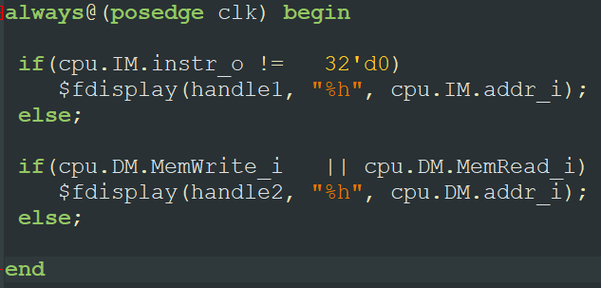
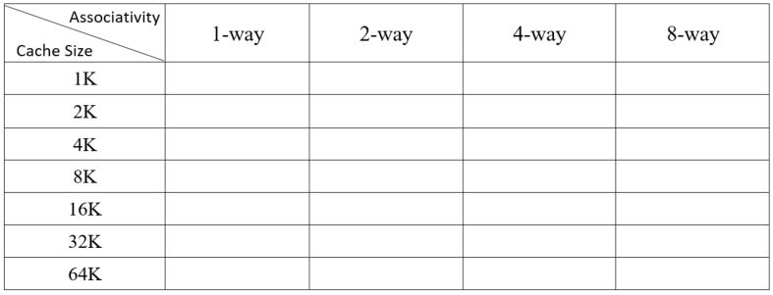
Memory Trace
Direct Mapped Cache:
- direct_mapped_cache.cpp
ICACHE.txt
memory traces for Instruction Memory
DCACHE.txt
Memory traces for Data Memory
N-way Set Associative Cache:
- set_associative_cache.cpp
- LRU.txt

Slide 4
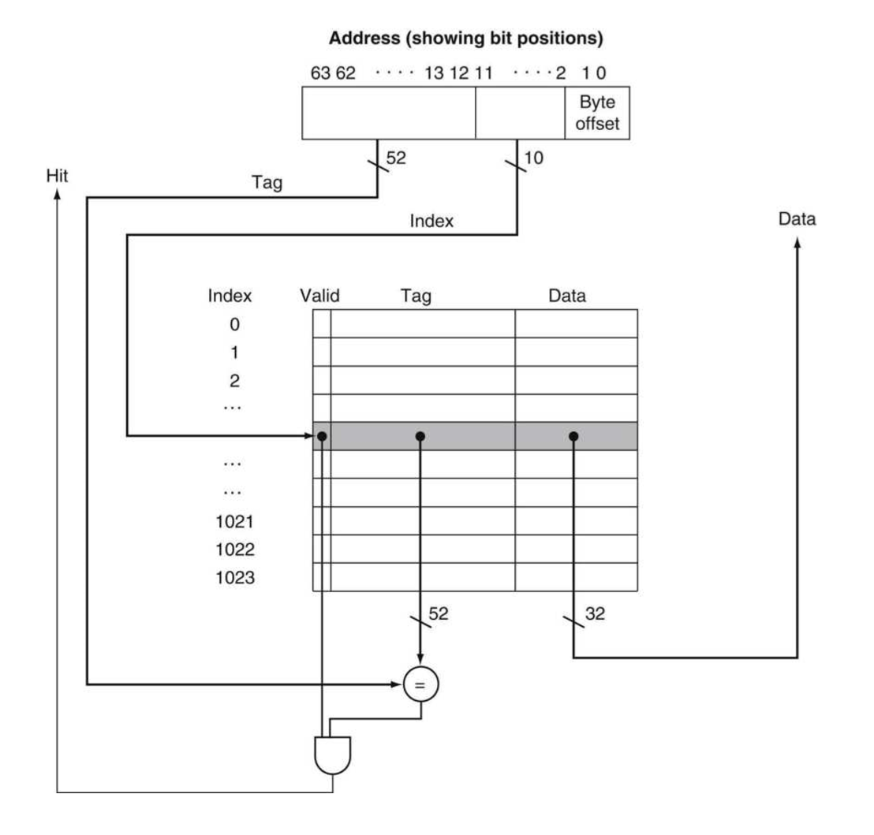
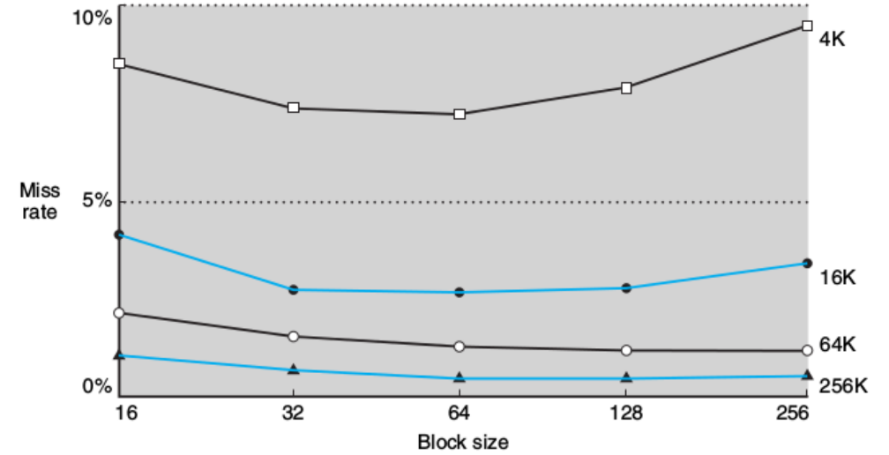
Direct Mapped Cache
Cache size

Slide 5
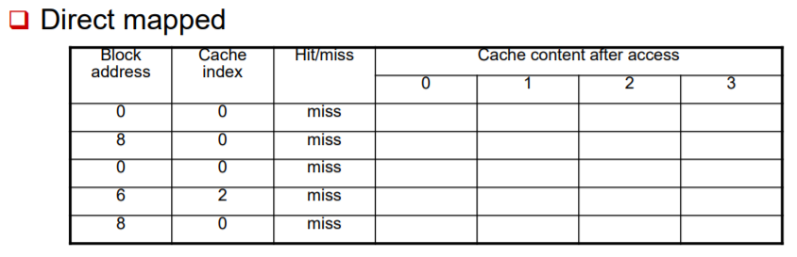
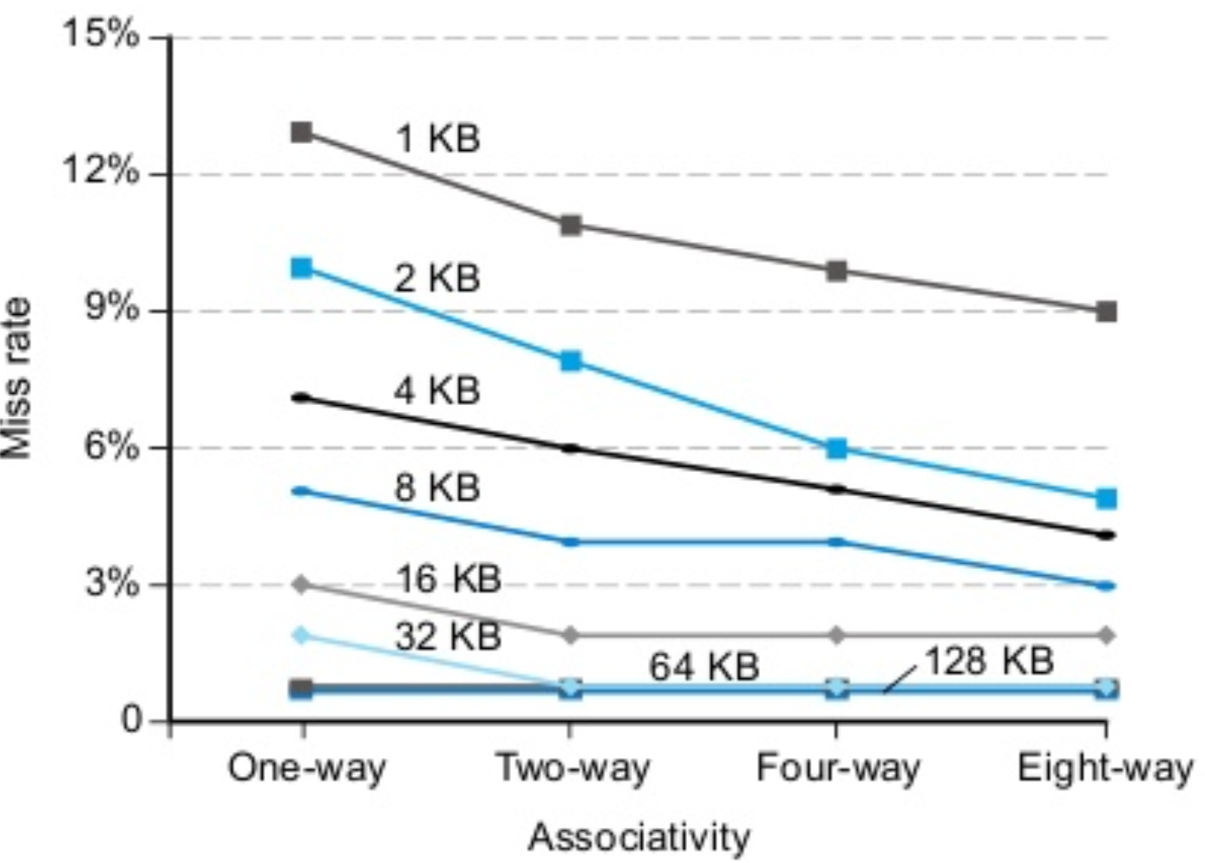
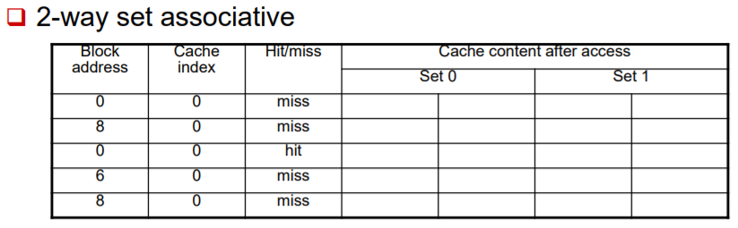
N-way Set Associative Cache
implement an n-way set-associative cache simulator using LRU
Set block size = 64 bytes
Cache size

Slide 6

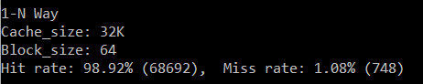
Output format
Direct Mapped Cache
Cache size, Block size, Hit rate, Miss rate
N-way Set Associative Cache
- Associative, Cache size, Block size, Hit rate, Miss rate

Slide 7
Report submission requirement
Must Contain:
Direct Mapped Cache - output result (mention on previous slide)
- draw graph and describe the reason for rise and fall
N-way Set Associative Cache
- output result (mention on previous slide)
- table (mention on slide 3)
- draw graph and describe the reason for rise and fall

